Slide 1
Asymptotic analysis of algorithms
Course Leader: Dr. Aruna Kumar S V

Slide 2
Session Objectives
At the end of this lecture, student will be able to
Explain the definition of asymptotic notations
Explain the lower bound, upper bound and tight bound case
Explain the asymptotic complexity behaviors of algorithms
Use asymptotic notation in equations

Slide 3
Session Contents
Asymptotic complexity of algorithms
Asymptotic notations Θ, O, Ω
Relations between Θ, O and Ω
Running times

Slide 4
Asymptotic complexity of algorithms
Running time of an algorithm as a function of input size n for large n
Expressed using only the highest-order term in the expression for the exact running time
– Instead of exact running time, say Θ(n²)
Describes behavior of function in the limit
Written using Asymptotic Notation

Slide 5
Asymptotic Notation
Θ, O, Ω,
Defined for functions over the natural numbers
– Ex: f(n) = Θ(n²)
– Describes how f(n) grows in comparison to n²
Define a set of functions, in practice used to compare two function sizes
The notations describe different rate-of-growth relations between the defining function and the defined set of functions

Slide 6
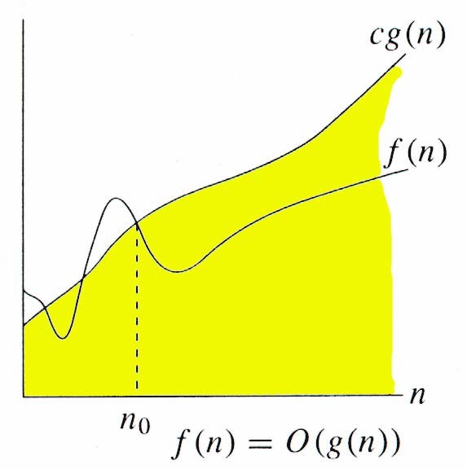
O-notation
For function g(n), we define O(g(n)), big-O of n, as the set:
O(g(n)) = {f(n) : ∃ positive constants c and n_{0,} such that ∀n ≥ n₀,
we have 0 ≤ f(n) ≤ cg(n) }
Intuitively: Set of all functions whose rate of growth is the same as or lower than that of g(n)
g(n) is an asymptotic upper bound for f(n)

Slide 7
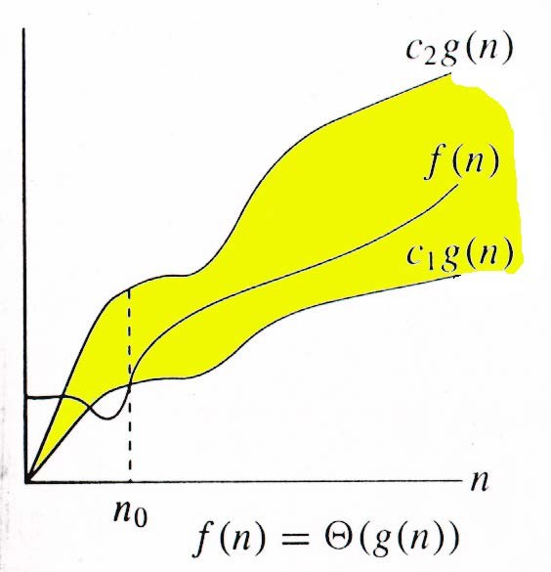
Θ-notation
For function g(n), we define Θ(g(n)), big-Theta of n, as the set:
Θ(g(n)) = {f(n) :
∃ positive constants c₁, c₂, and n_{0,}
such that ∀n ≥ n₀,
we have 0 ≤ c₁g(n) ≤ f(n) ≤ c₂g(n)
}
Intuitively: Set of all functions that have the same rate of growth as g(n)
g(n) is an asymptotically tight bound for f(n)

Slide 8
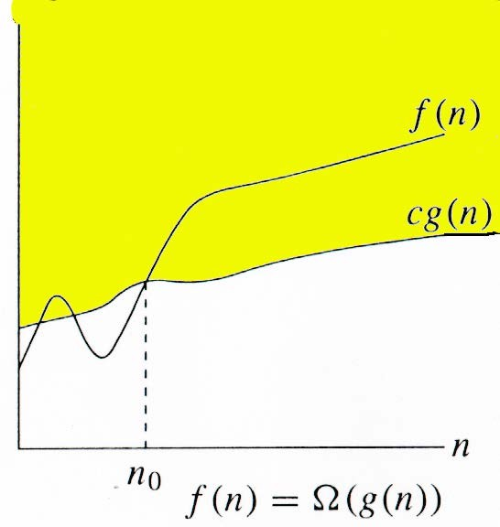
Ω -notation
For function g(n), we define Ω(g(n)), big-Omega of n, as the set:
Ω(g(n)) = {f(n) :
∃ positive constants c and n_{0,} such that ∀n ≥ n₀,
we have 0 ≤ cg(n) ≤ f(n)}
Intuitively: Set of all functions whose rate of growth is the same as or higher than that of g(n).
g(n) is an asymptotic lower bound for f(n).

Slide 9
Relations Between Θ, O, Ω
Asymptotic tight bound
Asymptotic upper bound
Asymptotic lower bound

Slide 10


Relations Between Θ, O, Ω
Theorem : For any two functions g(n) and f(n), f(n) = Θ(g(n)) if
f(n) = O(g(n)) and f(n) = Ω(g(n))
That is, Θ(g(n)) = O(g(n)) ∩ Ω(g(n))
In practice, asymptotically tight bounds are obtained from asymptotic upper and lower bounds

Slide 11
Properties
Transitivity
f(n) = Θ(g(n)) & g(n) = Θ(h(n)) ⇒ f(n) = Θ(h(n))
f(n) = O(g(n)) & g(n) = O(h(n)) ⇒ f(n) = O(h(n))
f(n) = Ω(g(n)) & g(n) = Ω(h(n)) ⇒ f(n) = Ω(h(n))
f(n) = o (g(n)) & g(n) = o (h(n)) ⇒ f(n) = o (h(n))
f(n) = ω(g(n)) & g(n) = ω(h(n)) ⇒ f(n) = ω(h(n))
Reflexivity
f(n) = Θ(f(n))
f(n) = O(f(n))
f(n) = Ω(f(n))
Symmetry
Complementarity
f(n) = O(g(n)) iff g(n) = Ω(f(n))
f(n) = o(g(n)) iff g(n) = w((f(n))
f(n) = Θ(g(n)) iff g(n) = Θ(f(n))

Slide 12
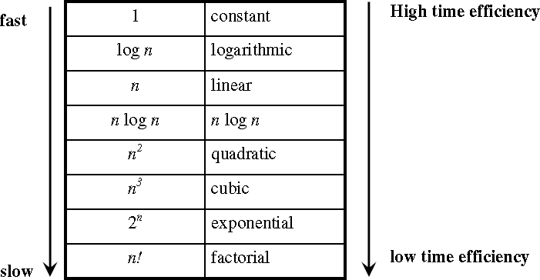
Basic Efficiency Classes

Slide 13
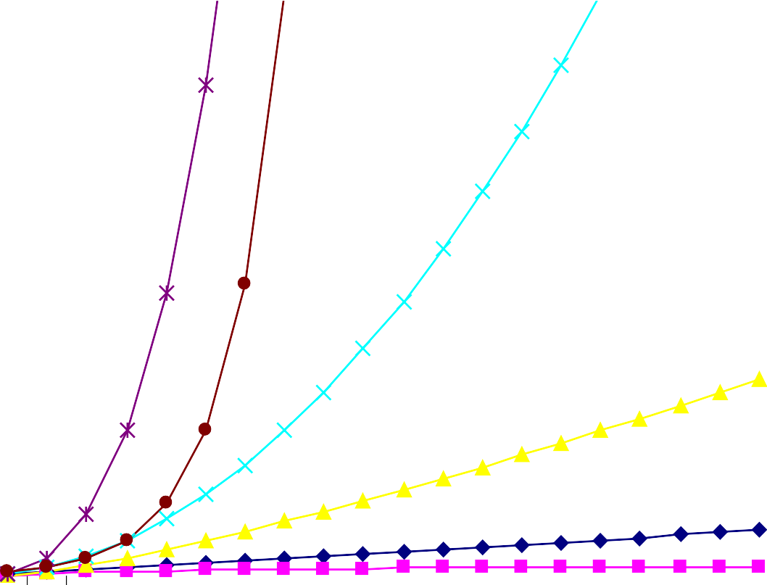
Practical Complexity
250
f(n) = n
f(n) = log(n)
f(n) = n log(n) f(n) = n^2
f(n) = n^3 f(n) = 2^n
0
1 2 3 4 5 6 7 8 9 10 11 12 13 14 15 16 17 18 19 20

Slide 14
Summary
Asymptotic
algorithm analysis studies how the values of functions
compare as their arguments grow without bounds
Ignores constants and the behavior of the function for small arguments acceptable because all algorithms are fast for small inputs and growth of running time is more important than constant factors
Ignoring the usually unimportant details and it obtain a representation that succinctly describes the growth of a function as its argument grows and thus allows us to make comparisons between algorithms in terms of their efficiency

Slide 15
References
1. Corman, T.H., Lieserson, C.E. and Rivest, R.L. (2009) Introduction to Algorithms, 3rd edn. Prentice Hall
Further Reading
Kleinberg, J. and Tardos, E. (2005) Algorithm Design, Addison-Wesley
Aho, A. V., Hopcropt, J. E., and Ulman, J. D. (1974) The Design and Analysis of Computer Algorithms, Addison-Wesley

